Slide 1









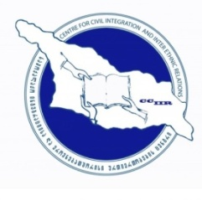
Project title: "Development and Introduction of Multilingual Teacher Education Programs at Universities of Georgia and Ukraine” DIMTEGU
AIM: To prepare the University faculty members of Georgia and Ukraine to apply modern pedagogical methods in MA programs in multilingual education.
Donor: TEMPUS program; European Commission
Dates: 2013/16
DIMTEGU Consortium Meeting
Workshop
April 2nd-5th 2016, Kiev, Ukraine
Hotel "Kozatskiy" Conference Hall
http://dimtegu.tsu.ge/

Slide 2




About CCIIR
Centre for Civil Integration and Inter-Ethnic Relations (CCIIR) - non-governmental, non-commercial organization.
Working on needs and demands existing in education system of Georgia.
The main goal of the organization is to support the integration and re-integration process of ethnic minority population of Georgia through empowerment, advocacy, capacity building and education interventions enabling them to be equal participants of social, cultural, political and economic life of the country.
The diverse and multilevel approach including development of teaching, learning and methodological resources, training courses and workshops for teachers and educators, development of university programs and courses, mobilization of local population and awareness raising campaigns, study tours and exchange programs - this is an incomplete list of those interventions the organization is undertaking regularly.
Since 2005
(Programs & Priorities)
Multilingual/Multicultural Educational Projects
Policy study & Analysis
Teachers' Education
Higher Education Programs
Youth Development
Literacy and bi-literacy
Tbilisi, 8/90 Mtskheta St.
www.cciir.ge
+99532 2922595
info@cciir.ge

Slide 3
Background of CCIIR activities for the support of multilingual education since 2005
Involved in the process of developing multilingual education policy and strategy by Ministry of Education of Georgia
Organized 3 (1 international) conferences on multilingual education and second language teaching (2008-2015)
In 2010-2011 years within the OSCE funded project “Supporting MLE Reform in Georgia” and with cooperation of CCIIR, TSU and Samtskhe-Javakheti State University BA level program of multilingual education (primary grade) and subject syllabuses were developed.
As one of the components of the ongoing TEMPUS project it is planned to implement and provide accreditation of that program.
In 2011 CCIIR in cooperation of TSU started working on developing ongoing TEMPUS project. Project staff members: Shalva Tabatadze, Nino Sharashenidze and Kakha Gabunia are members of CCIIR since 2005.

Slide 4
In the framework of DIMTEGU CCIIR worked on the following components:
Conduction teachers professional development training sessions
Publishing international electronic journal of multilingual education
Translation of the textbooks

Slide 5
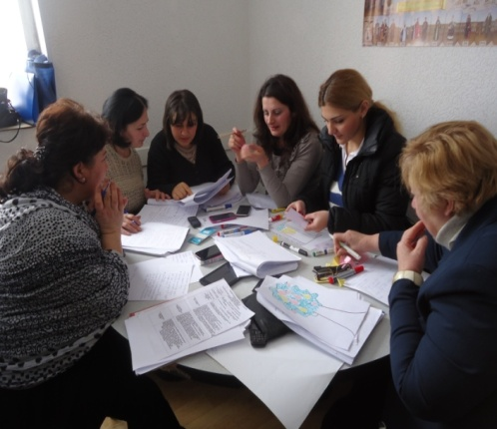
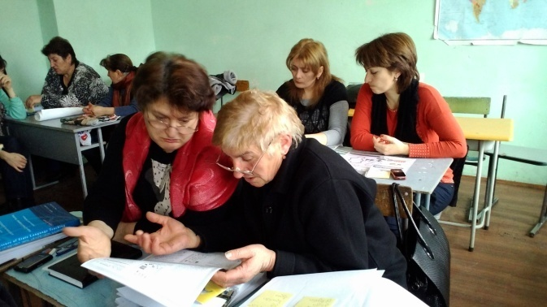
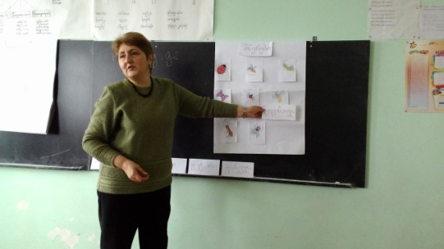
Training Sessions
Center for Civil Integration and Inter-ethnic Relations with the cooperation of TSU, Samtskhe-Javakheti State University and TPDC conducted professional development trainings for teachers -"Bilingualism and bilingual education principles; Content and Language Integrated Learning“. The training program aimed to improve the performance of primary grade teachers and Georgian as a second language teachers of non-Georgian schools. Trainings were conducted in 5 cities of non-Georgian population.
50 teachers of primary grade and Georgian as a second language were retrained by CCIIR.
Training venue: Marneuli, Bolnisi
The training program consisted of 45 contact hours (9 days)
Dates: November-December, 2014
The training participants were awarded certificates

Slide 6

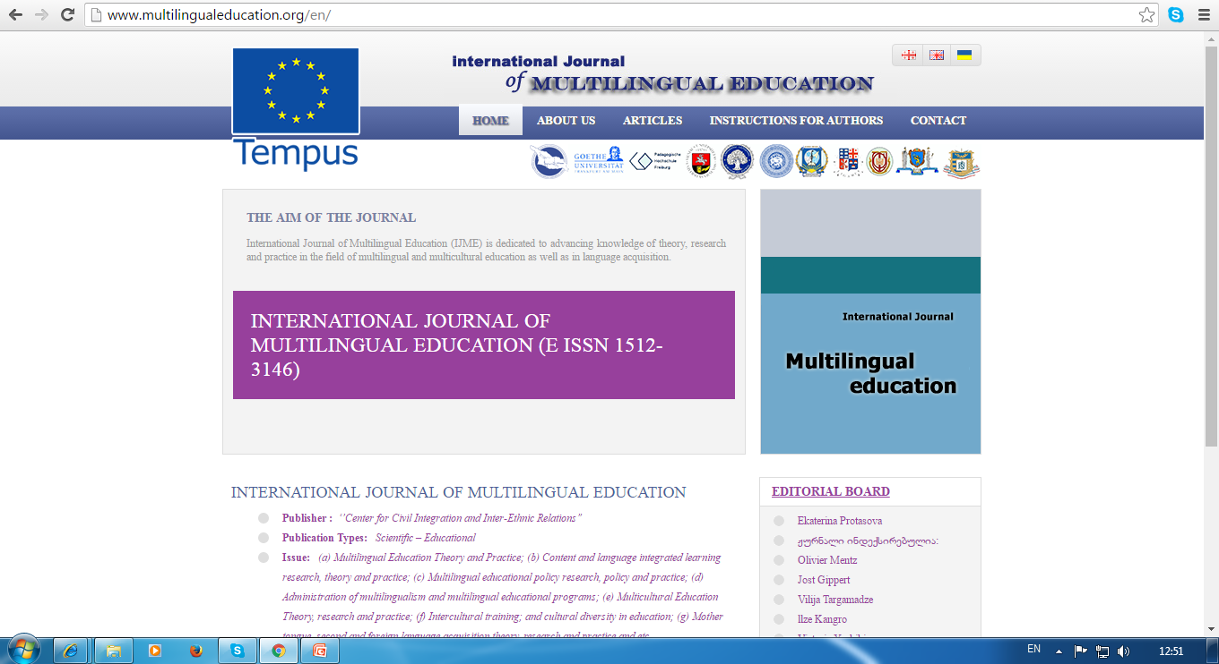
www.multilingualeducation.org

Slide 7
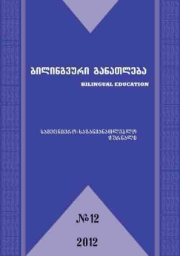
Previous experience
In 2010-13, CCIIR was publishing scientific-methodological journal ,,Bilingual Education’’ quarterly in the framework of the project - ‘’Supporting Multilingual Educational Reform in Georgia’’ funded by OSCE High Commissioner on National Minorities. The journal was available in electronic version and print version.
The journal strived for dissemination of information on bilingual education and encouraged development of scientific and academic study and analysis of the direction.
Armenian and Azerbaijani translation of the journal was also supported by the project and all non-Georgian schools were provided with the Journals.

Slide 8
www.multilingualeducation.org
International electronic Journal of Multilingual Education (IJME) is dedicated to advancing knowledge of theory, research and practice in the field of multilingual and multicultural education as well as in language acquisition. The journal publishes reviews and empirical research (both full length papers and brief reports) with high priority given to manuscripts that join theory and research with applications.
Publisher : ”Center for Civil Integration and Inter-Ethnic Relations’’ CCIIR
CCIIR has been publishing journal within the project “Development and Introduction of Multilingual Teacher Education Programs at Universities of Georgia and Ukraine” funded by the European Commission TEMPUS program since 2013
Publication Types: Scientific – Educational , e-journal
Language: trilingual (available in Georgian, Ukrainian and English)
Frequency: Biannual Totally: 6 volumes have been published (2 last volumes will be available in October, 2016)
Journal is indexed

Slide 9
The aim and target groups of the Journal
Aim:
Support dissemination of knowledge about bilingual education
Encourage networking between scholars and practitioners
Develop academic and scientific researches
Dissemination of research results
Develop bilingual education in Georgia as an interdisciplinary scientific field
Support integration of scholars and practitioners working in that field
Support effective introduction of multilingual education programs in general education system
Target groups:
BA, MA and PhD students
Academic staff
Administration
Scholars, researchers who work in the fields of education, linguistics, political science, psychology, communication, education, management, sociology and related disciplines.

Slide 10
Topics & Issues of the Journal
Multilingual and multicultural educational policy research, theory and practice
Content and language integrated learning research, theory and practice
Teachers education/professional development
Foreign language teaching/learning strategies
Education management
Language identity; Language policy
Cultural identity
Learning platforms
Research results & analysis
Practical examples/sharing experience

Slide 11
Articles
Approximately 6-7 articles written by different authors in each volume (each volume in each language - 100 pages )
All published articles are selected based on peer review process. The professors of consortium member universities participate in the peer review process. The peer review of the articles is done at least by randomly selected two reviewers.
The articles are submitted in Georgian, English or Ukrainian languages. All accepted articles are translated and published in three languages. The translation of articles from Georgian into English and vice versa is done by CCIIR. The translation from Ukrainian to English and vice versa is undertaken by Dnipropetrovsk University.
The authors of the articles are program participants, academics and/or independent researchers.

Slide 12
Articles according to the countries & universities
Countries/ Universities | Goethe University of Frankfurt | University of Latvia; Liepaja University (1) | Vilnius University; Kaunas University of Technology (1) | ILIA Uni | TSU | Samtskhe-Javakheti Uni | Crimean Univer sity | Ivan Franko National Univer sity | Oles Honchar Dnipropetrovsk National University | Total number of the articles:
Germany | 2 |  |  |  |  |  |  |  |  | 2
Latvia |  | 2 |  |  |  |  |  |  |  | 2
Lithuania |  |  | 1 |  |  |  |  |  |  | 1
Georgia |  |  |  | 1 | 14 | 1 |  |  |  | 16
Ukraine |  |  |  |  |  |  | 5 | 2 | 13 | 20
Total number of the articles: |  |  |  |  |  |  |  |  |  | 41
Notes:
Some of the volumes of the journal have several authors from the same or different universities, so the total number of the articles is given according to the countries

Slide 13

Editorial Board
Ekaterina Protasova | University of Helsinki Finland | Finland
Olivier Mentz | PädagogischeHochschule Freiburg | Germany
Jost Gippert | Johnan Wolfgang Goethe-Universitaet Frankfurt (JWGU) | Germany
Vilija Targamadze | Vilnius University (VU), Faculty of Philosophy | Lithuania
llze Kangro | University of Latvia (UL) | Latvia
Victoria Yashikina | Oles Honchar Dnipropetrovsks National University (DNU) | Ukraine
Iryna Losyeva | Ivan Franko National University of Lviv(IFNUL) | Ukraine
Natela Imedadze | Ilia State University | Georgia
Ramaz Kurdadze | Tbilisi State University (TSU) | Georgia
Mzia Tsereteli | Tbilisi State University (TSU) | Georgia
Rhonda Sofer | Gordon Academic College of Education | Israel
Merab Beridze | Samtkhe-Javakheti State Teaching University (SISTU) | Georgia

Slide 14
Indexing
Academickeys
http://education.academickeys.com/jour_main.php
Academic Resource Index
http://journalseeker.researchbib.com/view/issn/1512-3146
Open Academic Journals index
http://oaji.net/journal-detail.html?number=2822
General Impact factor
http://www.generalimpactfactor.com/jdetails.php?jname=International+Journal+of+Multilingual+Education
SindexS
http://www.sindexs.org/JournalList.aspx?ID=2340
Ufactor
http://www.uifactor.org/JournalDetails.aspx?jid=4452
Erih Plus
https://dbh.nsd.uib.no/publiseringskanaler/erihplus/periodical/info?id=488058
ISSUU
https://issuu.com/signin?onLogin=%2Fhome%2Fpublications%3Fq%3Dmultilingualeducation.org
Google Scholar
https://scholar.google.com/scholar?q=multilingualeducation.org&btnG&hl=en&as_sdt=0%2C5
Directory of Research Journals Indexing
http://www.drji.org/JournalProfile.aspx?jid=1512-3146

Slide 15
Translation of Textbooks

Slide 16
Background
The most important direction of the organization is to develop resources for teaching Georgian language: methodological resources for teachers and brochures, language policy documents, research reports etc.
CCIIR translated and developed up to 50 methodological textbooks, brochures: methods of teaching second language (8 brochures), etc.

Slide 17
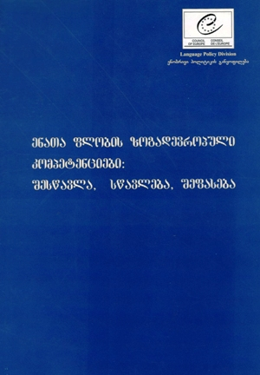
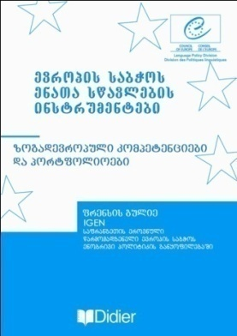
    10 books about multilingual education and second language teaching were published by Language Department of Council of Europe:
    Common European Framework of Reference for Languages: Learning , Teaching , Assessment (2008)
    Common European Framework of Reference for Languages: Learning , Teaching , Assessment. Guide for users (2008)
    Common European Framework of Reference for Languages: Learning , Teaching , Assessment. Case studies (2008)
    Jean-Claude Beacco , Michael Byram: GUIDE FOR THE DEVELOPMENT OF LANGUAGE EDUCATION POLICIES IN EUROPE (2008)
    Goullier Francis: Council of Europe tools for language teaching: Common European Framework and Portfolios (2008)
    Ó Riagáin Pádraig&Lüdi Georges, Bilingual education: some policy issues (2008)
    Multilingual Education in Europe; 50th anniversary of International Cooperation (2008)

Slide 18

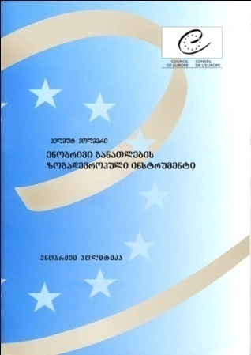
  Martyniuk Waldek, ,,European Frameworks of Reference for Language Competences’’ (2008)
  Vollmer Helmut, ,,Towards a Common European Instrument for Language(s) of Education (2008)
  Beacco Jean-Claude: Languages and Language Repertoires: Plurilingualism as a way of life in Europe (2008)
Methods of teaching native language and literature, Maia Inasaridze, (2007)
“Bilingual Education; Guide for Teachers (2009)
“Foundations of Bilingual Education and Bilingualism”, Colin Baker (2010)
Content and Language Integrated Teaching (grades: VII-XII), 7 books in 7 subjects (Geography, Physic, History, Mathematics, Chemistry, Civil Education, Biology) 2010

Slide 19
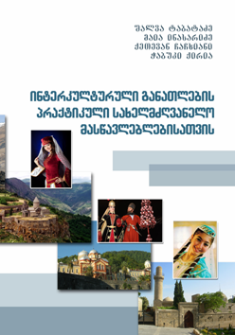
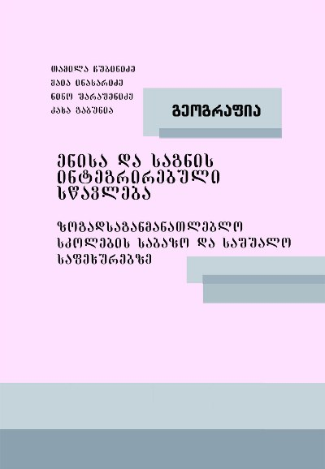
Language Assessment and Testing - Manual for Teachers (K.Gabunia, M.Inasaridze, M.Tsereteli) 2011
Practical guide of Intercultural Education for teachers (Sh. Tabatadze; M. Inasaridze; q. Chachkhiani, Ch. Qiria ) 2010
More info
http://cciir.ge/index.php?module=text&link_id=30

Slide 20
Translation of Textbooks
Selection of textbooks:
The most important textbooks in the field of education, multilingual education, intercultural education, linguistics and psychology.

Slide 21
Translated Books
7 textbooks out of 12 were translated and edited in the reporting period:
Action Research for the Teachers: Travelling the yellow brick road;
2. Coyle,D., Hood, P., Marsh.D. (2010): Content and language integrated learning (CLIL);
3. Mehisto, P., Marsh, D., Frigols, M. (2008): Uncovering CLIL: Content and Language Integrated Learning in Bilingual and Multilingual Education;
4. Teaching 101: Classroom Strategies for the Beginning teacher by Jeffrey G. Glanz;
5. Cummins, J., Swain, M. (1992). Bilingualism in Education;
6. Introducing Second Language Acquisition (Cambridge Introductions to Language and Linguistics) by Professor Muriel Saville-Troike;
7. Hughes, Arthur (2003). Testing for Language Teachers.

Slide 22
Translation of textbooks
7. Creating Literacy Instruction for All Students, Thomas G. Gunning, Publisher- Pearson; 8th edition
8. Introducing Second Language Acquisition (Cambridge Introductions to Language and Linguistics) by Professor Muriel Saville-Troike (Edition: 2nd) publisher- Cambridge University press, 2012
9. Differentiated Instructional Strategies in Practice: Training, Implementation, and Supervision Gayle H. Gregory (Author) publisher- Corwin, 2nd edition
10.Teaching 101: Classroom Strategies for the Beginning teacher by Jeffrey G. Glanz, Publisher- Corwin, 2nd Edition
11. Stephanie L. McAndrews, Diagnostic Literacy Assessments and Instructional Strategies: A Literacy Specialists Resource, 2008, Publisher- International Reading Association
12. Hughes, Arthur (2003). Testing for Language Teachers. Publisher - Cambridge University Press

Slide 23
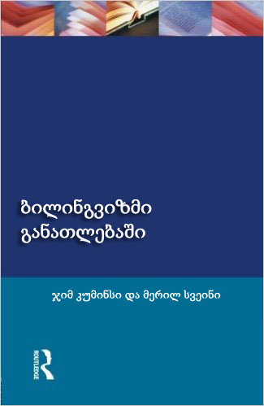
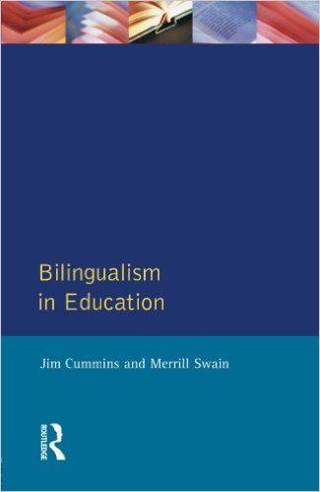

Slide 24
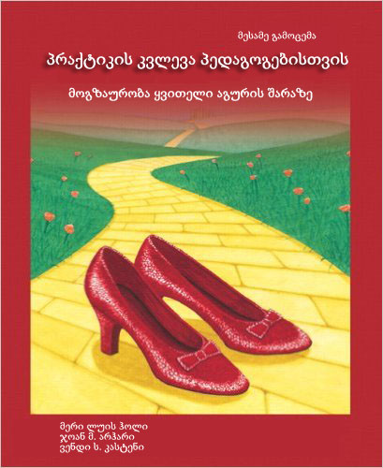


Slide 25
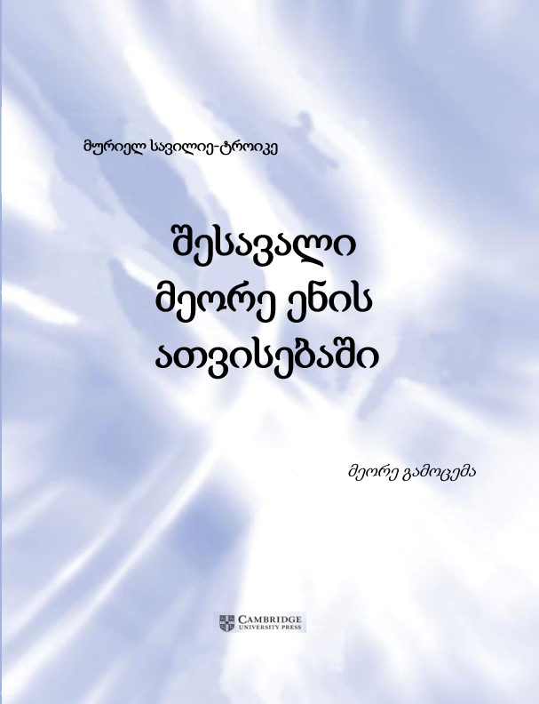
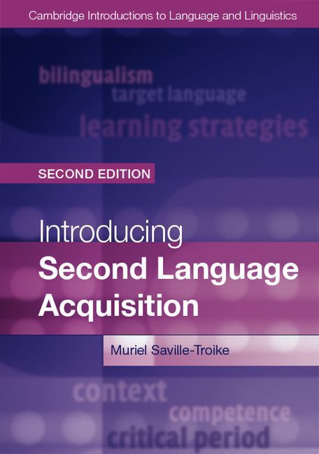

Slide 26

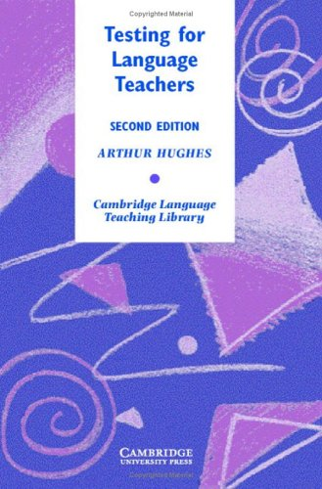

Slide 27
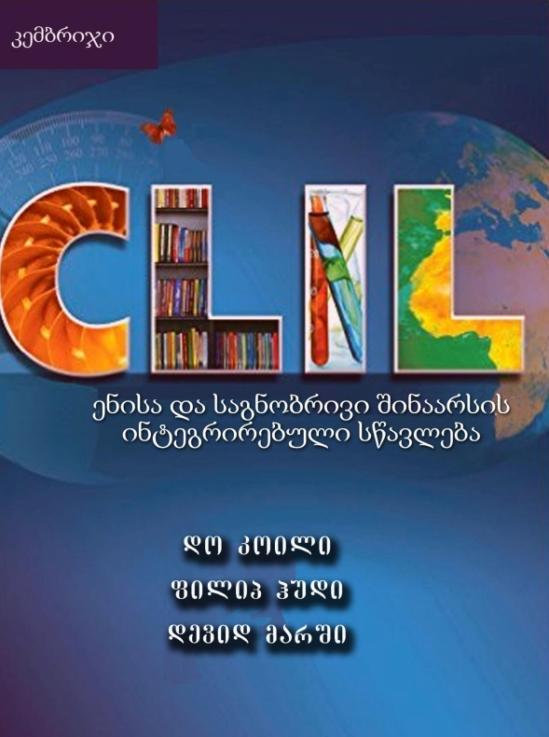
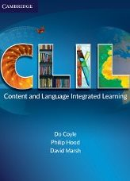

Slide 28
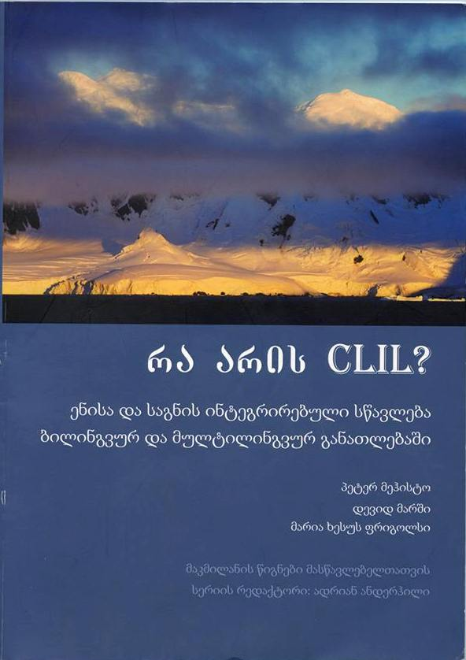
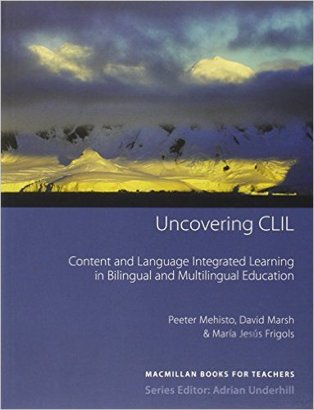

Slide 29
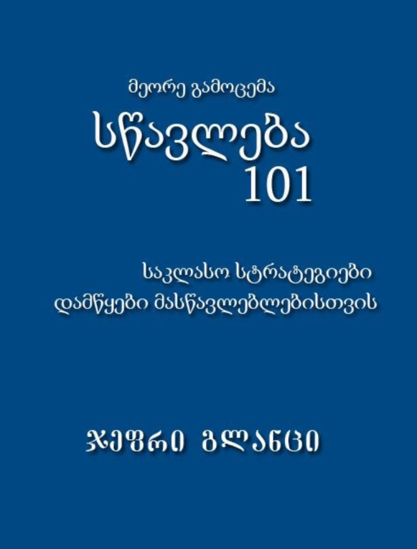
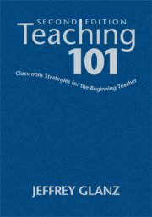

Slide 30
Ketevan Jachvadze, Communications Manager, CCIIR | +995 595511050 | ketevanjachvadze@gmail.com
Mariam Kartvelishvili, Project Assistant, CCIIR |
+995 577130298 | mariam_kartvelishvili@yahoo.com
Tamar Antadze, Project Assistant, CCIIR |
+995 598599822 | takoantadze@gmail.com
Elene Jajanidze, Project Coordinator, CCIIR |
+995 595580280 | ejajanidze@cciir.ge
THANK YOU!

